Slide 1
HTML DOM
DOM stands for Document Object Model. When a browser loads a web page, the browser creates a Document Object Model of that page. The HTML DOM is created as a tree of Objects.
The HTML DOM is a standard for how to get, change, add, or delete HTML elements.
Example:
<html>
<head>
<title>My Page Title</title>
</head>
<body>
<script type="text/javascript">
</script>
<div>
<h1>This is browser DOM</h1>
</div>
</body>
</html>

Slide 2
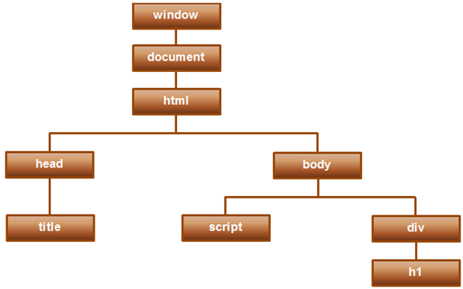
HTML DOM
For this HTML a graphical representation of the Document Object Model is shown below.

Slide 3
HTML DOM
With the object model, JavaScript gets all the power it needs to create dynamic HTML:
JavaScript can change all the HTML elements in the page
JavaScript can change all the HTML attributes in the page
JavaScript can change all the CSS styles in the page
JavaScript can remove existing HTML elements and attributes
JavaScript can add new HTML elements and attributes
JavaScript can react to all existing HTML events in the page
JavaScript can create new HTML events in the page

Slide 4
DOM Methods
The HTML DOM can be accessed with JavaScript (and with other programming languages).
In the DOM, all HTML elements are defined as objects.
The programming interface is the properties and methods of each object.
A property is a value that you can get or set (like changing the content of an HTML element).
A method is an action you can do (like add or deleting an HTML element).

Slide 5
DOM Methods (Example)
The following example changes the content (the innerHTML) of the <p> element with id="demo":
<html> <body> <p id="demo"></p> <script> document.getElementById("demo").innerHTML = "Hello World!"; </script> </body> </html>
In the example above, getElementById is a method, while innerHTML is a property.

Slide 6
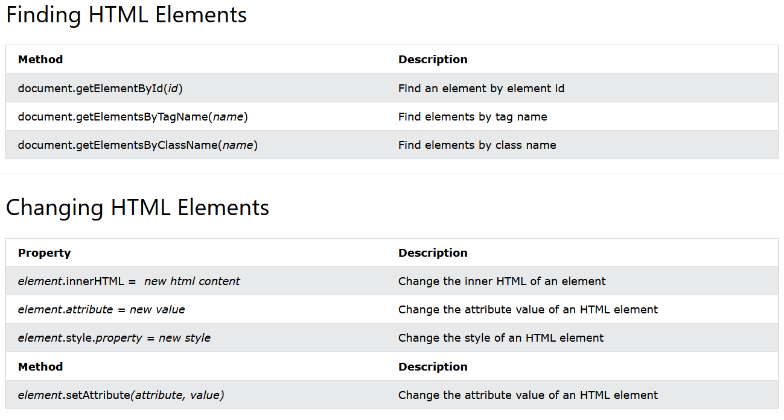
DOM Document

Slide 7
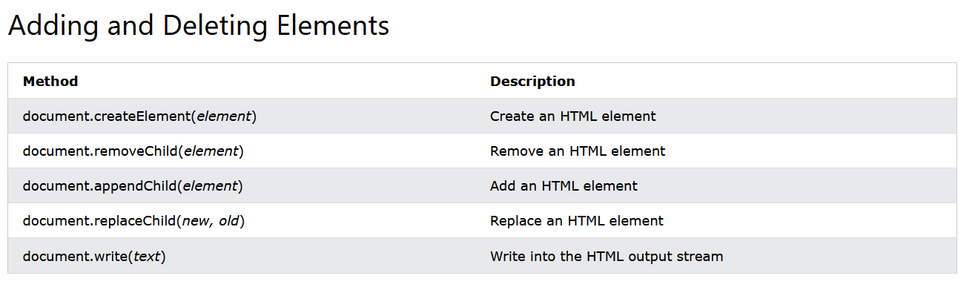
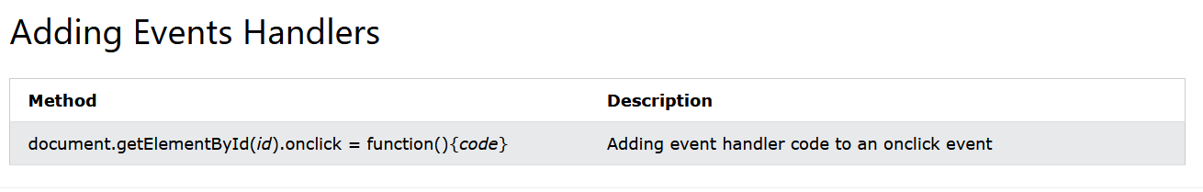
DOM Document

Slide 8
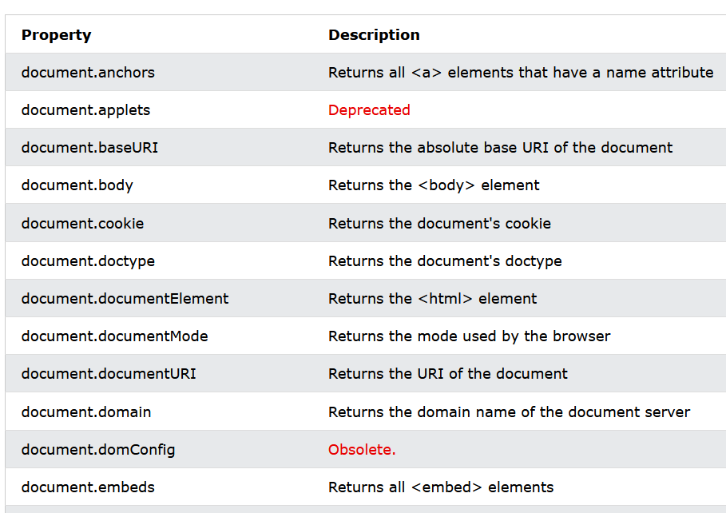
DOM Document

Slide 9
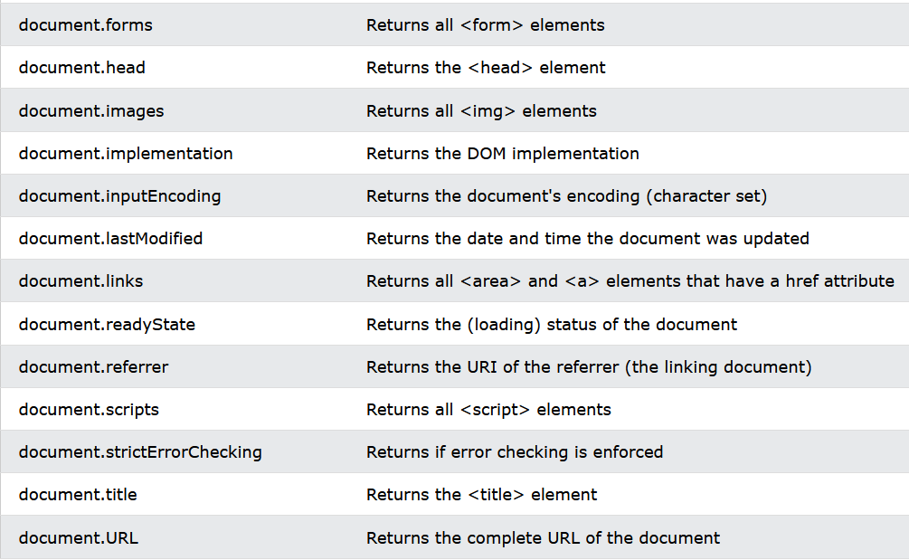
DOM Document

Slide 10
DOM Elements
With JavaScript, you want to manipulate HTML elements.
To do so, you have to find the elements first. There are several ways to do this:
Finding HTML elements by id
Finding HTML elements by tag name
Finding HTML elements by class name
Finding HTML elements by CSS selectors
Finding HTML elements by HTML object collections

Slide 11
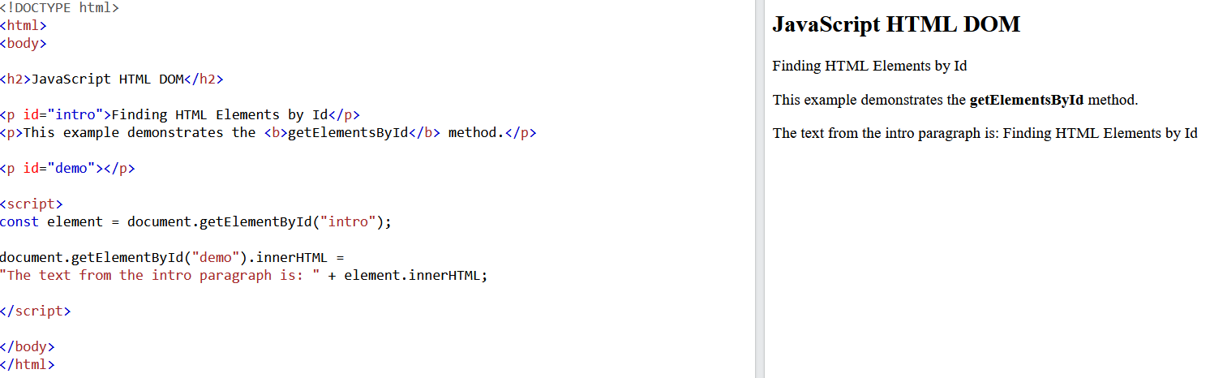
DOM Elements

Slide 12
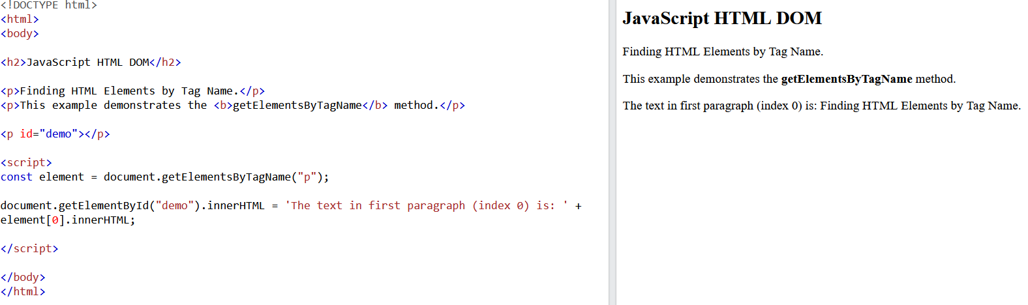
DOM Elements

Slide 13
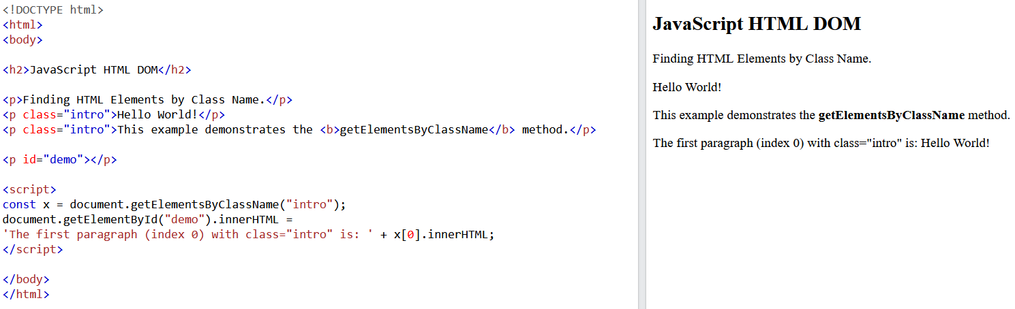
DOM Elements

Slide 14
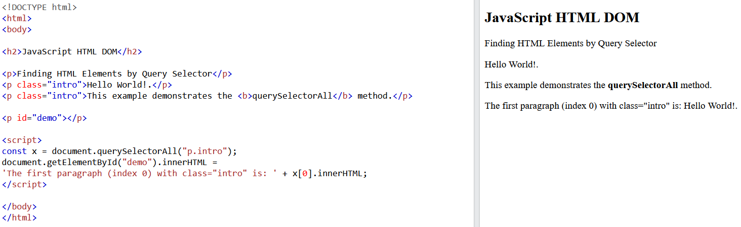
DOM Elements

Slide 15
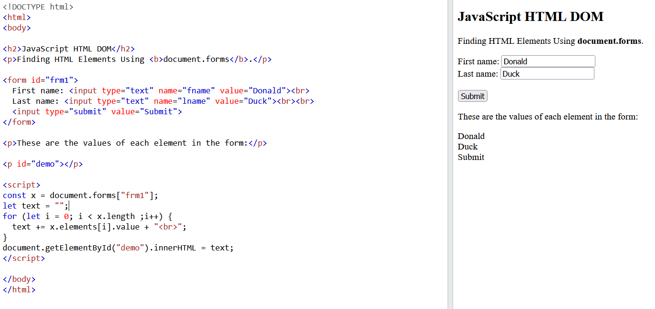
DOM Elements

Slide 16
HTML DOM
The HTML DOM allows JavaScript to change the content of HTML elements.
Change HTML Content
Change the Value of an Attribute
Dynamic HTML content

Slide 17
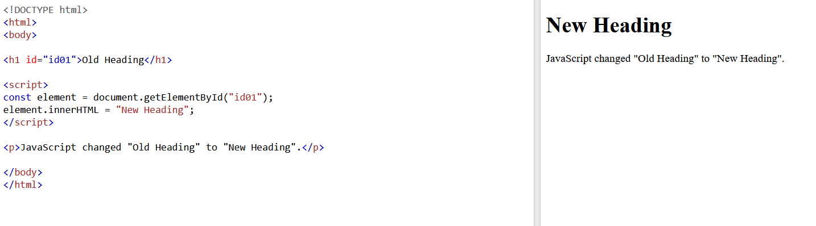
HTML DOM
Change HTML Content

Slide 18
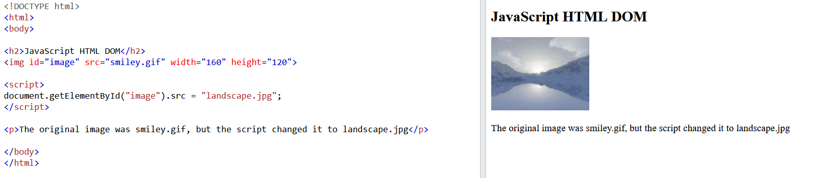
HTML DOM
Change the Value of an Attribute

Slide 19
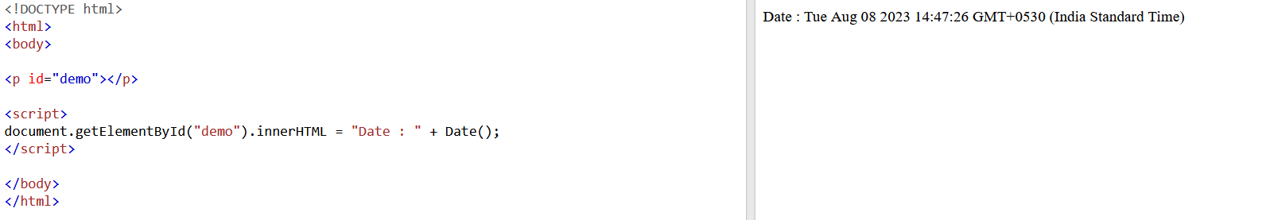
HTML DOM
Dynamic HTML content

Slide 20
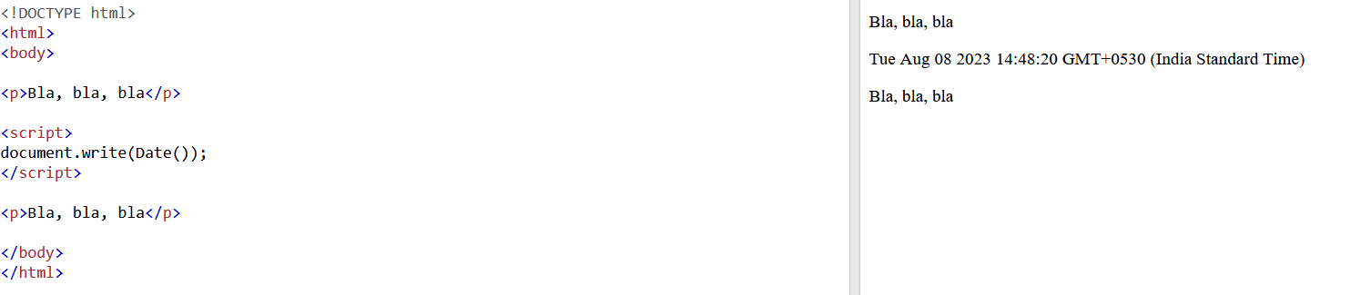
HTML DOM
Document.write()

Slide 21
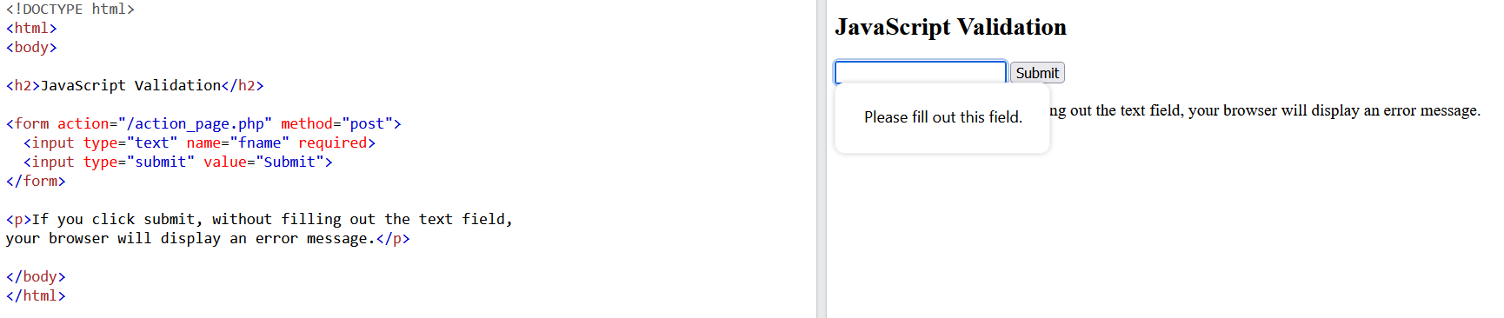
DOM Forms
HTML form validation can be performed automatically by the browser:

Slide 22
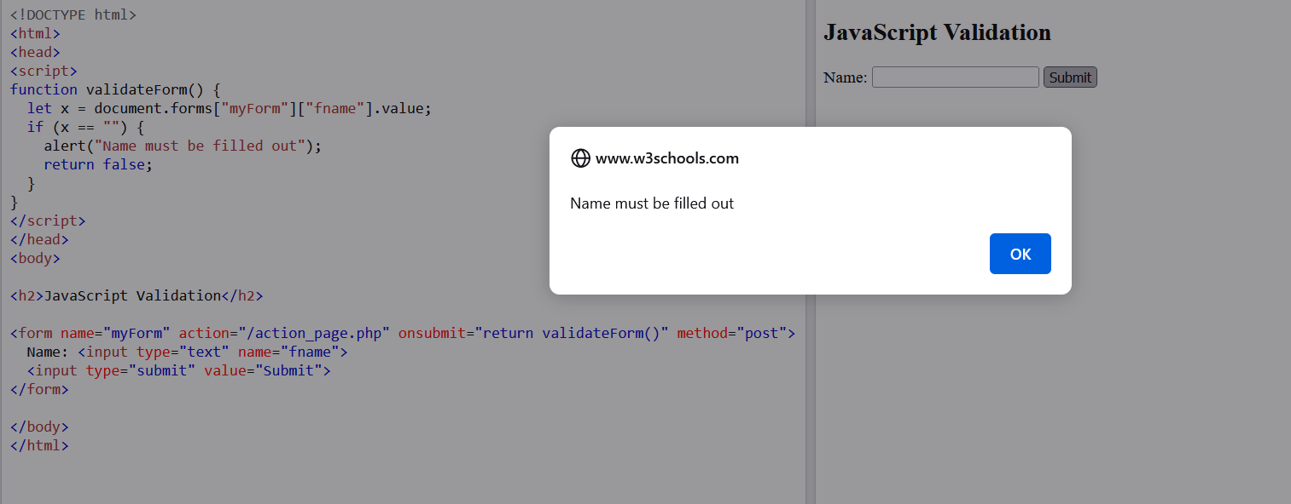
DOM Forms
HTML form validation can be performed manually:

Slide 23
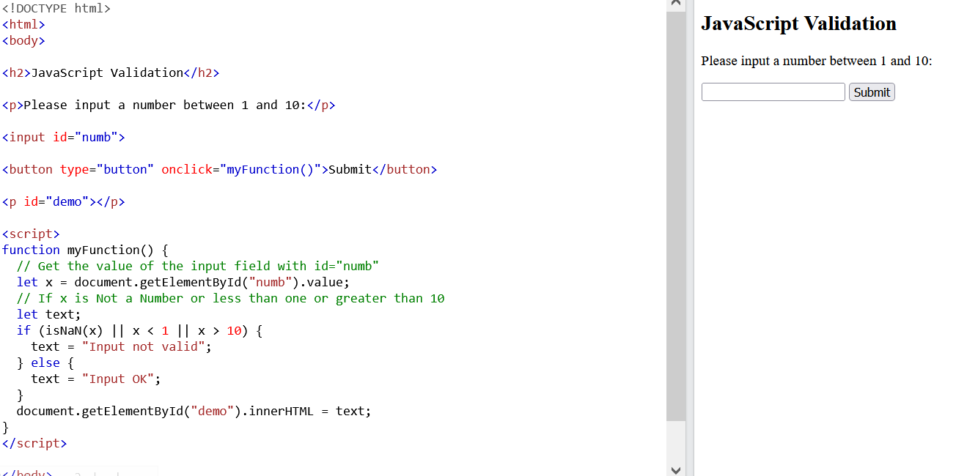
DOM Forms
HTML form validation for numeric values:

Slide 24
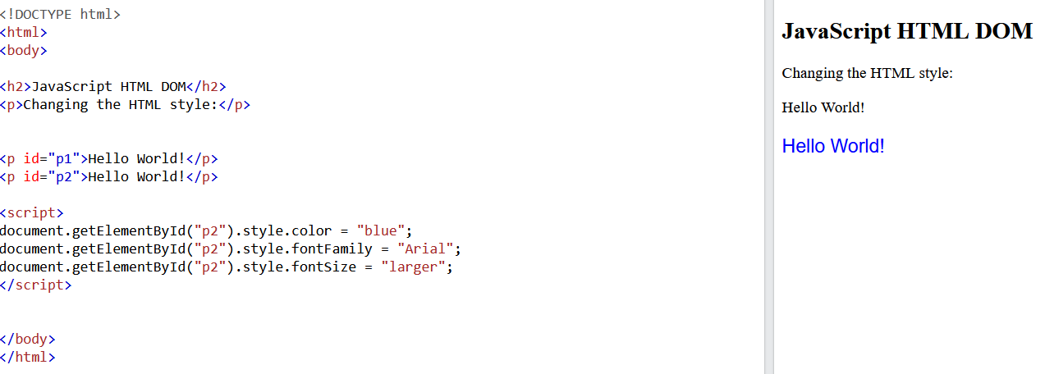
DOM CSS
document.getElementById(id).style.property = new style:

Slide 25
DOM CSS
Using Events
The HTML DOM allows you to execute code when an event occurs.
Events are generated by the browser when "things happen" to HTML elements:
An element is clicked on
The page has loaded
Input fields are changed

Slide 26
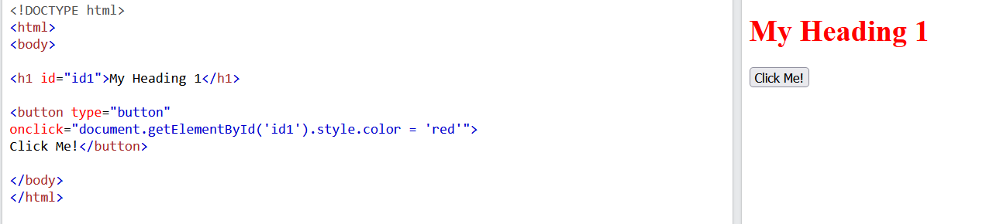
DOM CSS

Slide 27
DOM Events
A JavaScript can be executed when an event occurs, like when a user clicks on an HTML element.
To execute code when a user clicks on an element, add JavaScript code to an HTML event attribute:
onclick=JavaScript
Examples of HTML events:
When a user clicks the mouse
When a web page has loaded
When an image has been loaded
When the mouse moves over an element
When an input field is changed
When an HTML form is submitted
When a user strokes a key

Slide 28
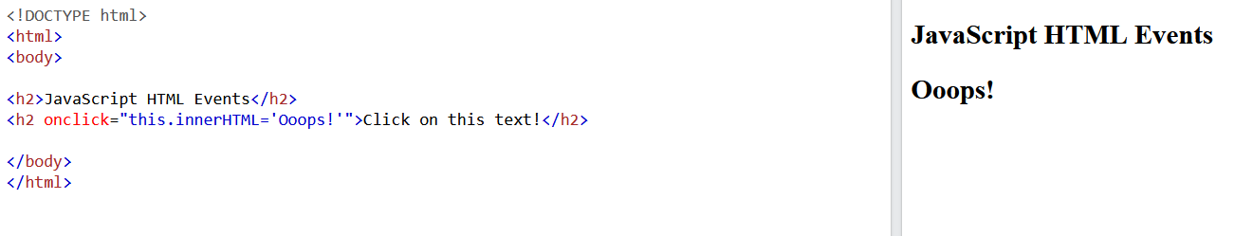
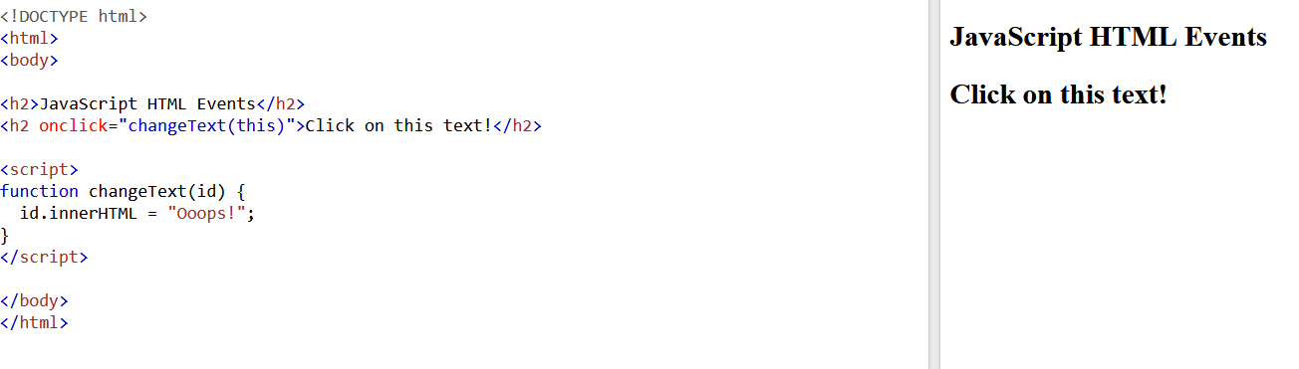
DOM Events

Slide 29
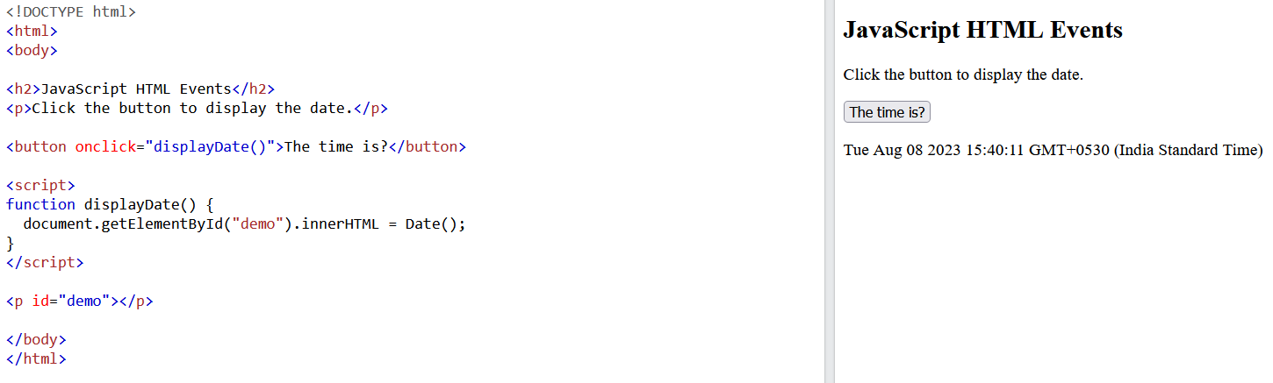
DOM Events

Slide 30
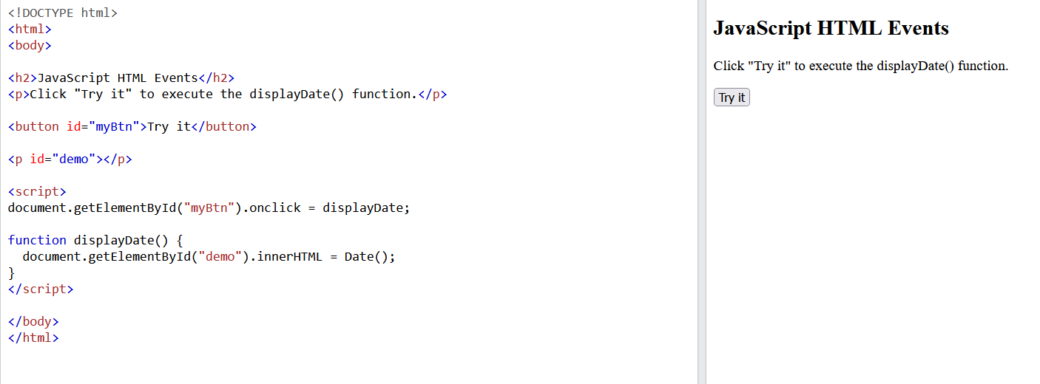
DOM Events
HTML Event Attributes

Slide 31
DOM Events
Assign Events Using the HTML DOM

Slide 32
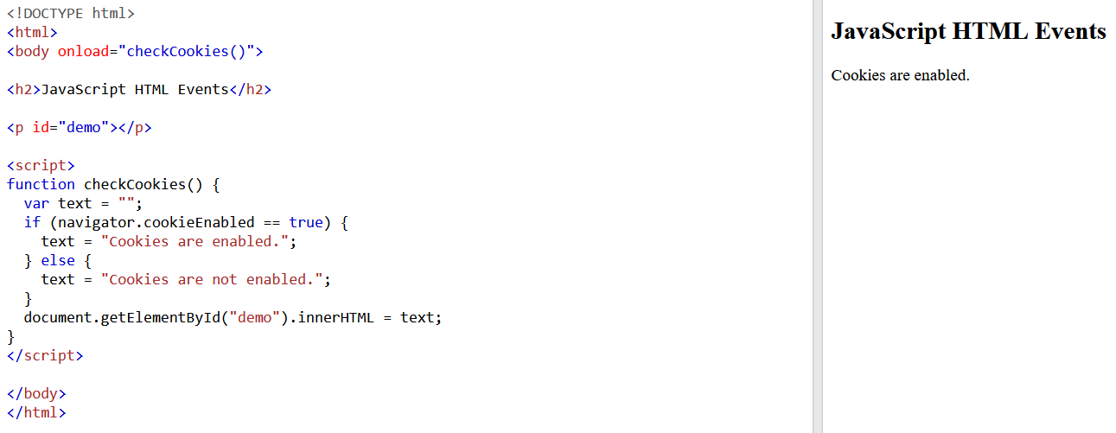
DOM Events
The onload and onunload Events
The onload and onunload events are triggered when the user enters or leaves the page.
The onload event can be used to check the visitor's browser type and browser version, and load the proper version of the web page based on the information.
The onload and onunload events can be used to deal with cookies.

Slide 33
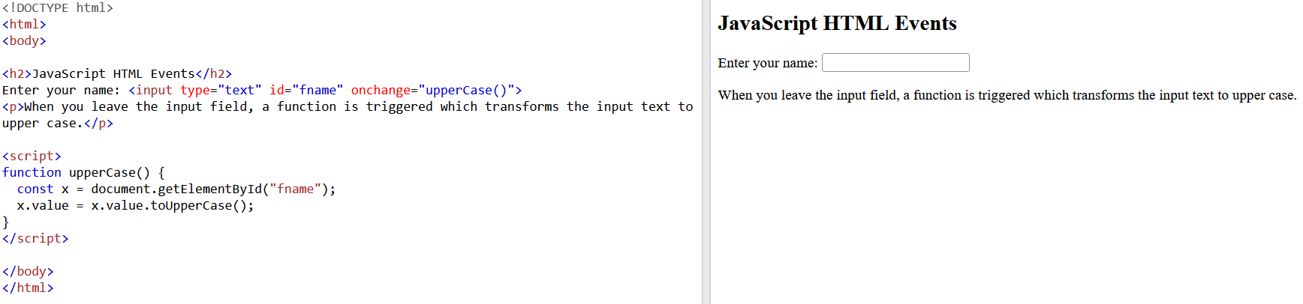
DOM Events
The onchange Event
The onchange event is often used in combination with validation of input fields.
Below is an example of how to use the onchange. The upperCase() function will be called when a user changes
the content of an input field.

Slide 34
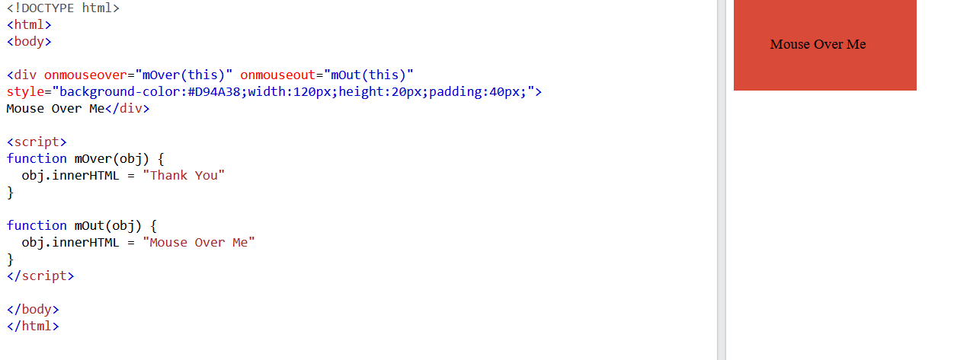
DOM Events
The onmouseover and onmouseout Events

Slide 35
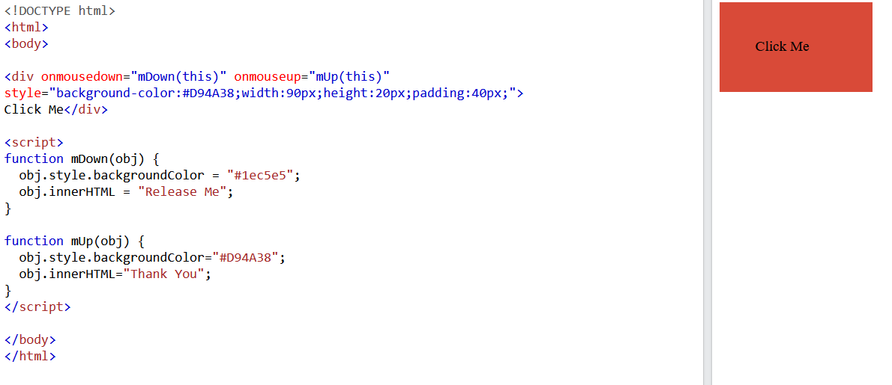
DOM Events
The onmousedown, onmouseup and onclick Events

Slide 36
DOM Event Listener
The addEventListener() method attaches an event handler to the specified element.
The addEventListener() method attaches an event handler to an element without overwriting existing
event handlers.
You can add many event handlers to one element.
You can add many event handlers of the same type to one element, i.e two "click" events.
You can add event listeners to any DOM object not only HTML elements. i.e the window object.
The addEventListener() method makes it easier to control how the event reacts to bubbling.
When using the addEventListener() method, the JavaScript is separated from the HTML markup, for
Better readability and allows you to add event listeners even when you do not control the HTML markup.
You can easily remove an event listener by using the removeEventListener() method.

Slide 37
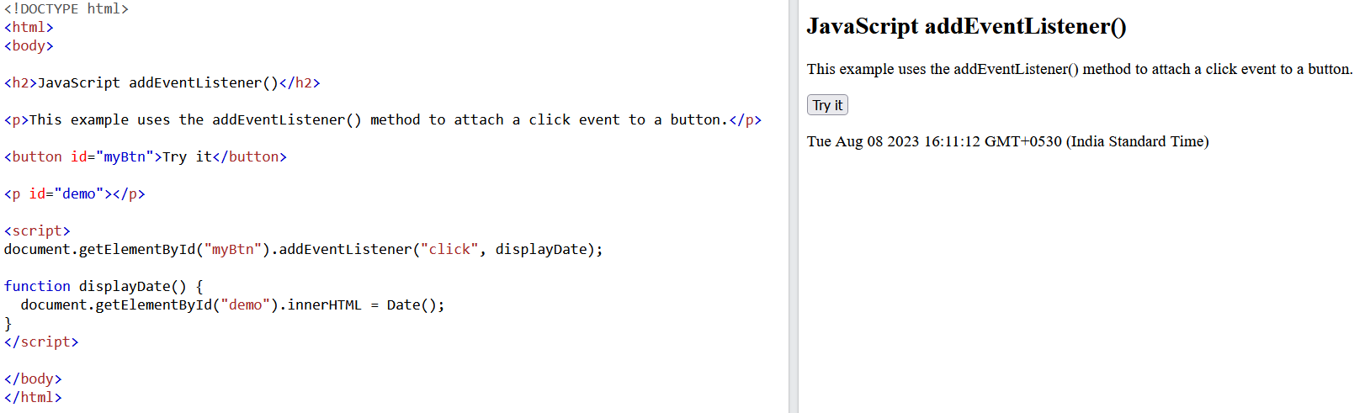
DOM Event Listener

Slide 38
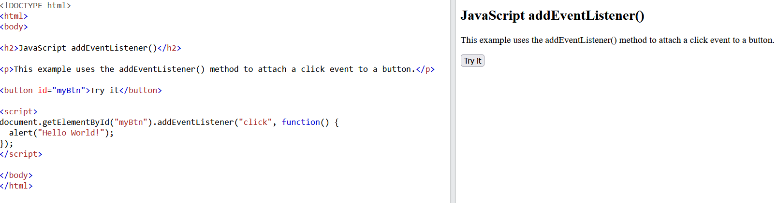
DOM Event Listener
Add an Event Handler to an Element

Slide 39
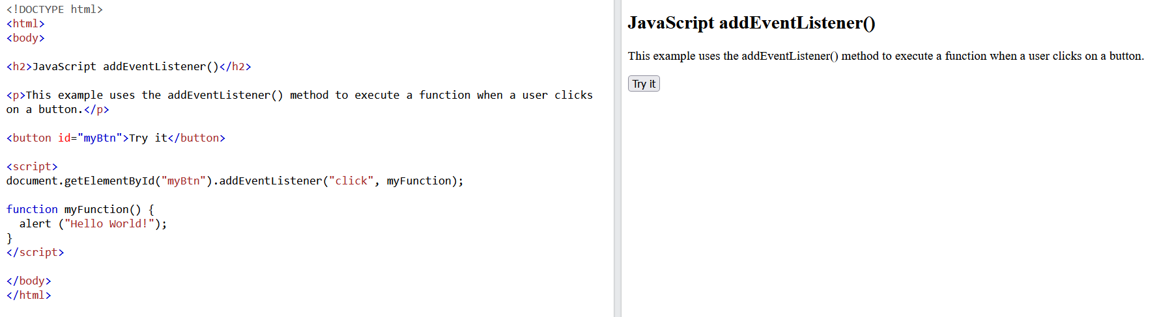
DOM Event Listener

Slide 40
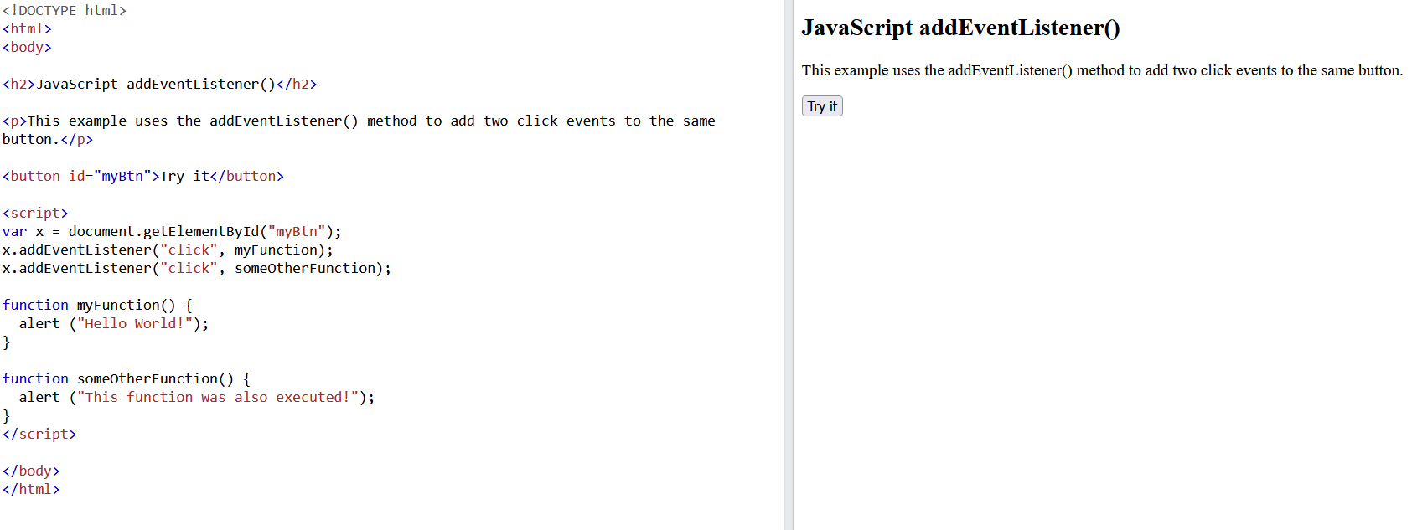
DOM Event Listener
Add Many Event Handlers to the Same Element

Slide 41
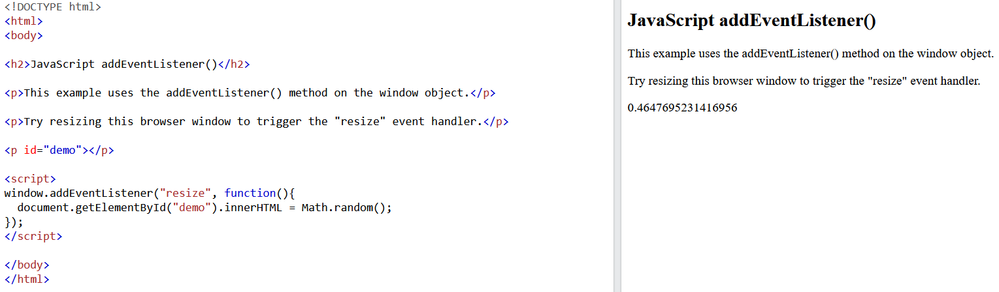
DOM Event Listener
Add an Event Handler to the window Object

Slide 42
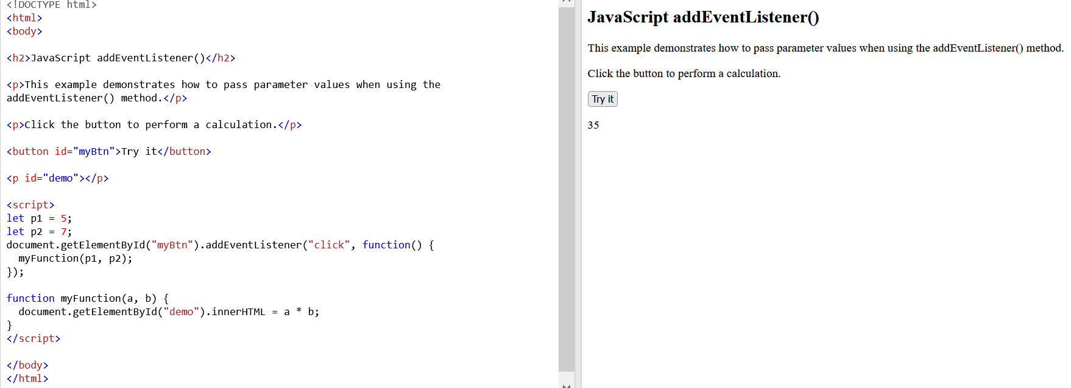
DOM Event Listener
Passing Parameters

Slide 43
Event Bubbling or Event Capturing?
There are two ways of event propagation in the HTML DOM, bubbling and capturing.
Event propagation is a way of defining the element order when an event occurs. If you have a <p> element inside a <div> element, and the user clicks on the <p> element, which element's "click" event should be handled first?
In bubbling the inner most element's event is handled first and then the outer: the <p> element's click event is handled first, then the <div> element's click event.
In capturing the outer most element's event is handled first and then the inner: the <div> element's click event will be handled first, then the <p> element's click event.
With the addEventListener() method you can specify the propagation type by using the "useCapture" parameter:
addEventListener(event, function, useCapture);
The default value is false, which will use the bubbling propagation, when the value is set to true, the event uses the capturing propagation.

Slide 44
Event Bubbling or Event Capturing?
<!DOCTYPE html>
<html>
<head>
<style>
#myDiv1, #myDiv2 {
background-color: coral;
padding: 50px;
}
#myP1, #myP2 {
background-color: white;
font-size: 20px;
border: 1px solid;
padding: 20px;
}
</style>
<meta content="text/html; charset=utf-8" http-equiv="Content-Type">
</head>
<body>
<h2>JavaScript addEventListener()</h2>
<div id="myDiv1">
<h2>Bubbling:</h2>
<p id="myP1">Click me!</p>
</div><br>
<div id="myDiv2">
<h2>Capturing:</h2>
<p id="myP2">Click me!</p>
</div>
<script>
document.getElementById("myP1").addEventListener("click", function() {
alert("You clicked the white element!");
}, false);
document.getElementById("myDiv1").addEventListener("click", function() {
alert("You clicked the orange element!");
}, false);
document.getElementById("myP2").addEventListener("click", function() {
alert("You clicked the white element!");
}, true);
document.getElementById("myDiv2").addEventListener("click", function() {
alert("You clicked the orange element!");
}, true);
</script>
</body>
</html>

Slide 45
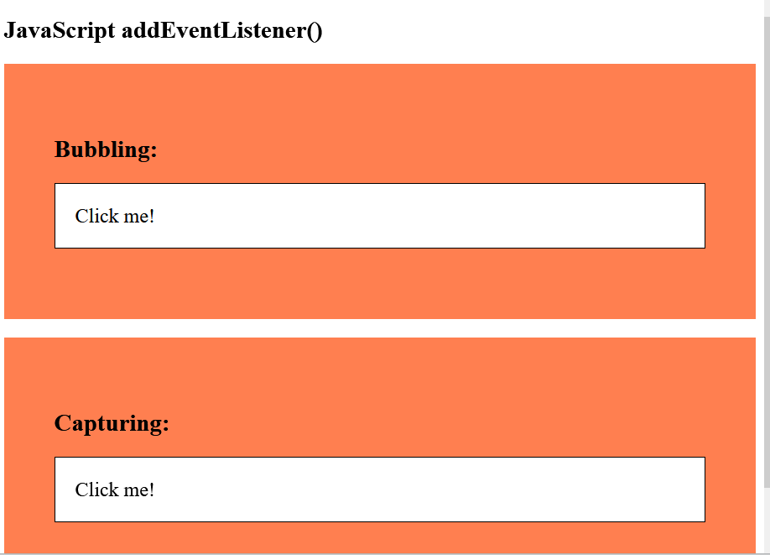
Event Bubbling or Event Capturing?

Slide 46
DOM Event Listener (Remove)
<!DOCTYPE html>
<html>
<head>
<style>
#myDIV {
background-color: coral;
border: 1px solid;
padding: 50px;
color: white;
font-size: 20px;
}
</style>
</head>
<body>
<h2>JavaScript removeEventListener()</h2>
<div id="myDIV">
<p>This div element has an onmousemove event handler that displays a random number every time you move your mouse inside this orange field.</p>
<p>Click the button to remove the div's event handler.</p>
<button onclick="removeHandler()" id="myBtn">Remove</button>
</div>
<p id="demo"></p>
<script>
document.getElementById("myDIV").addEventListener("mousemove", myFunction);
function myFunction() {
document.getElementById("demo").innerHTML = Math.random();
}
function removeHandler() {
document.getElementById("myDIV").removeEventListener("mousemove", myFunction);
}
</script>
</body>
</html>

Slide 47
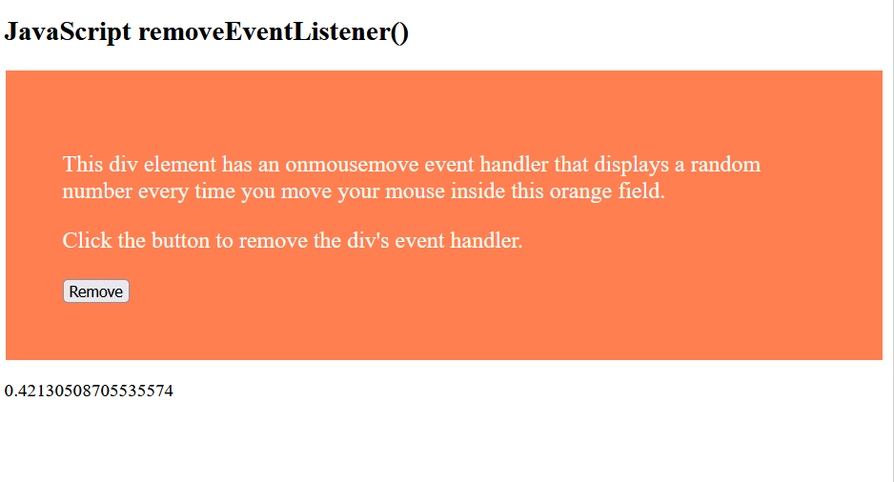
DOM Event Listener(Remove)

Slide 48

Image gallery with thumbnails in JavaScript
The image gallery should be as shown in the image below. When you click on the image thumbnail, the respective image should be displayed in the main section of the page.

Slide 49
<!DOCTYPE html>
<html>
<head>
<style type="text/css">
.imgStyle
{
width:100px;
height:100px;
border:3px solid grey;
}
</style>
</head>
<body>
<img id="mainImage" style="border:3px solid grey"
src="Images/1.jpg" height="500px" width="540x"/>
<br />
<div id="divId" onclick="changeImageOnClick(event)">
<img class="imgStyle" src="Images/1.jpg" />
<img class="imgStyle" src="Images/2.jpg" />
<img class="imgStyle" src="Images/3.jpg" />
<img class="imgStyle" src="Images/4.jpg" />
<img class="imgStyle" src="Images/5.jpg" />
</div>

Slide 50
<script type="text/javascript">
var images = document.getElementById("divId") .getElementsByTagName("img");
for (var i = 0; i < images.length; i++)
{
images[i].onmouseover = function ()
{
this.style.cursor = 'hand';
this.style.borderColor = 'red';
}
images[i].onmouseout = function ()
{
this.style.cursor = 'pointer';
this.style.borderColor = 'grey';
}
}

Slide 51
function changeImageOnClick(event)
{
event = event || window.event;
var targetElement = event.target || event.srcElement; document.getElementById("mainImage").src = targetElement.getAttribute("src");
}
</script>
</body>
</html>

Slide 52
<!DOCTYPE html>
<html>
<head>
<style type="text/css">
.imgStyle
{
width:100px;
height:100px;
border:3px solid grey;
}
</style>
</head>
<body>
<img id="mainImage" style="border:3px solid grey"
src="Images/1.jpg" height="500px" width="540x"/> <br />
<div id="divId" onclick="changeImageOnClick(event)">
<img class="imgStyle" src="Images/1.jpg" />
<img class="imgStyle" src="Images/2.jpg" />
<img class="imgStyle" src="Images/3.jpg" />
<img class="imgStyle" src="Images/4.jpg" />
<img class="imgStyle" src="Images/5.jpg" />
</div>

Slide 53
<script type="text/javascript">
var images = document.getElementById("divId").getElementsByTagName("img");
for (var i = 0; i < images.length; i++)
{
images[i].onmouseover = function ()
{
this.style.cursor = 'hand';
this.style.borderColor = 'red';
}
images[i].onmouseout = function ()
{
this.style.cursor = 'pointer';
this.style.borderColor = 'grey';
}
}

Slide 54
function changeImageOnClick(event)
{
event = event || window.event;
var targetElement = event.target || event.srcElement;
if (targetElement.tagName == "IMG")
{
mainImage.src = targetElement.getAttribute("src");
}
}
</script>
</body>
</html>

